Slide 1
PDF Chatbot
USING LANGCHAIN AND HUGGING FACE TRANSFORMERS
Karan Panchal
Natural Language Processing

Slide 2
INTRODUCTION
Problem Statement:
“Reading and searching through long documents is time-consuming and inefficient, especially for professionals managing large data volumes.”
Motivation:
“What if you could ask a document a question and get precise answers in seconds?”
Real-World Applications:
Legal Industry: Summarizing case files.
Healthcare: Extracting patient records.
Education: Navigating research papers and notes.

Slide 3
OBJECTIVE
Content:
“To build a chatbot that can extract, analyze, and answer user queries from PDF documents, enhancing productivity and accessibility.”
Why This Matters:
“Combines AI, natural language processing (NLP), and OCR technologies to revolutionize document analysis.”
Key Value:
Saves time.
Improves data access.
Minimizes manual effort.

Slide 4
ARCHITECTURE
[User Uploads PDF] → [Text Extraction] → [Vector Storage (FAISS)] →
[Question Input] → [Answer Generation]
Step-by-Step Workflow:
PDF Upload: Users upload PDF documents.
Text Extraction:
For text-based PDFs: Extract content using PyPDF2.
For scanned PDFs: Use Tesseract OCR.
Vector Embedding: Use FAISS and Hugging Face models for contextual search.
Question Answering: Answer queries using deepset/roberta-base-squad2.

Slide 5
TOOLS & TECHNOLOGIES
Core Technologies:
LangChain: For vector storage and retrieval.
Hugging Face Transformers: For question-answering models.
FAISS: For fast document search.
Tesseract OCR: For extracting text from scanned documents.
PyPDF2: Text-based PDF parsing.

Slide 6
IMPLEMENTATION
Workflow:
PDF Text Extraction
Interactive Chatbot
Question Answering

Slide 7
DEMO/RESULTS
Demo Steps:
PDF: Uploaded sample: The Legend of the Golden River.
Questions and Responses:
Q: "What was the name of the dragon guarding the river?"
A: "Azuron"
Q: "Why did Kael seek the Golden River?"
A: "To save his village."
HOW THE CHATBOT PERFORM

Slide 8
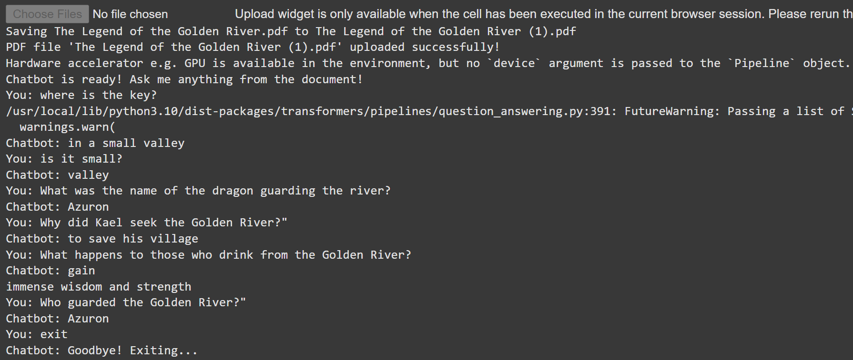

Slide 9
CHALLENGES
Scanned PDFs
Answer Accuracy
Interactive Workflow
Problem: Extracting clean text from scanned documents.
Solution: Integrated Tesseract OCR for accurate text extraction.
Problem: Extracting clean text from scanned documents.
Solution: Integrated Tesseract OCR for accurate text extraction.
Problem: Seamless PDF upload and chatbot interaction.
Solution: Designed a user-friendly Colab interface for dynamic interaction.

Slide 10
CONCLUSION
Highlights:
Built a chatbot capable of:
Handling diverse PDF formats (text and scanned).
Answering complex, context-specific questions.
Demonstrated the synergy between OCR, NLP, and user-friendly interfaces.
Future Enhancements:
Support for additional file types (Word, Excel).
Advanced fine-tuning for domain-specific queries.
Deployment for broader accessibility.

Slide 11
Thank you!
ANY QUESTIONS OR FEEDBACK?
Karan Panchal
Natural Language Processing

